Slide 1
HR Dataset Project
DATA ANALYSIS

Slide 2
Define Dataset
Download Dataset : https://www.kaggle.com/datasets/pavansubhasht/ibm-hr-analytics-attrition-dataset

Slide 3
Define Questions
# Question_1 : Distribution of age among the employees
# Question _2 : Attrition rates across different departments
# Question _3 : Average monthly income per job role
# Question 4 : Impact between Job Level and Monthly Income
# Question 5 : Impact between Years at Company and Years Since Last Promotion

Slide 4
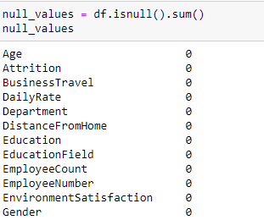
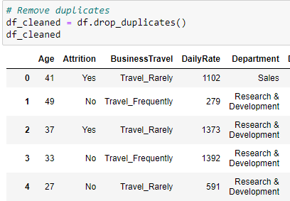
Data Cleaning

Slide 5
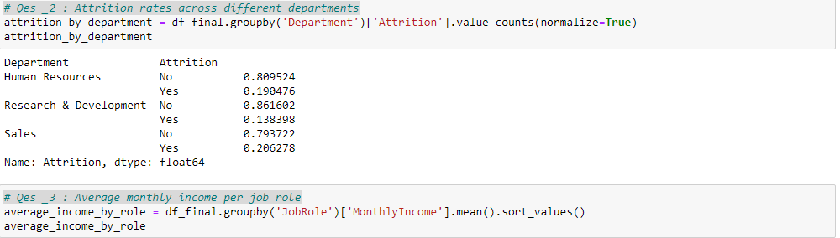
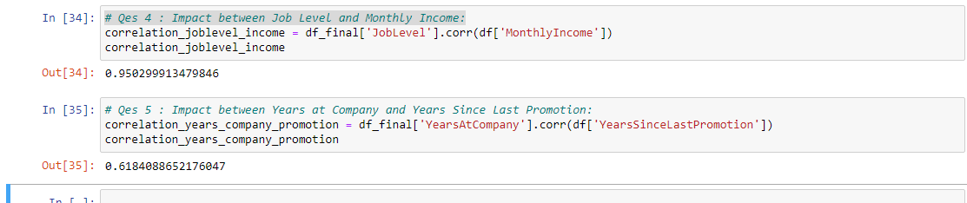
Exploratory Data Analysis

Slide 6
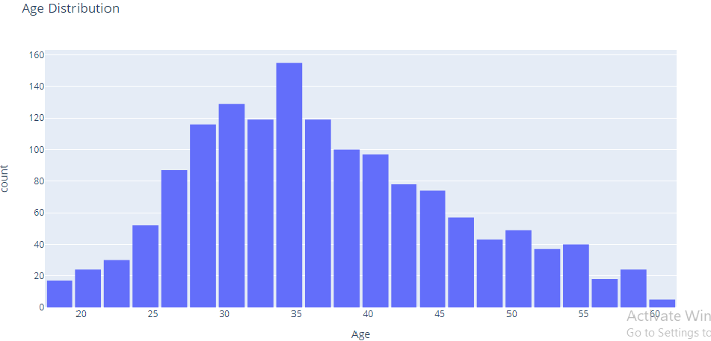
Data Visualization

Slide 7
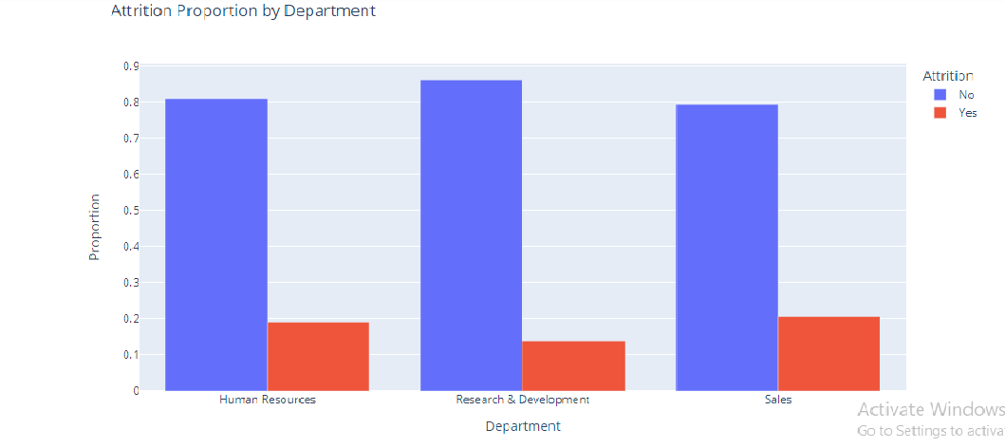
Data Visualization

Slide 8
Summary
Distribution of age among the employees:
The ages range from 18 to 60 years old.
The distribution shows that there are more employees in the age group of 35 is the most common ages, while ages 18 and 60 are the least common.

Slide 9
Summary
Attrition rates across different departments:
The attrition rate is highest in the Sales department at approximately 20.63%, followed by Human Resources at about 19.05%, and lowest in Research & Development at approximately 13.84%.

Slide 10
Summary
Average monthly income per job role:
The job roles with the lowest average monthly income are Sales Representatives , Laboratory Technicians , and Research Scientists .
The highest average incomes are for Research Directors and Managers .

Slide 11
Summary
Impact between Job Level and Monthly Income:
There is a very strong positive correlation between Job Level and Monthly Income, indicating that higher job levels tend to have higher monthly incomes.

Slide 12
Summary
Impact between Years at Company and Years Since Last Promotion:
There is a moderately strong positive correlation between the Years at the Company and the Years Since Last Promotion, suggesting that, generally, the longer employees have been at the company, the longer they have gone since their last promotion. ​

